Slide 1
Data-Driven Corporate Credit Assessment: Machine Learning Approaches to Scoring and Rating Prediction
Wu Lung Chieh
Huei Wen Teng
20251008

Slide 2
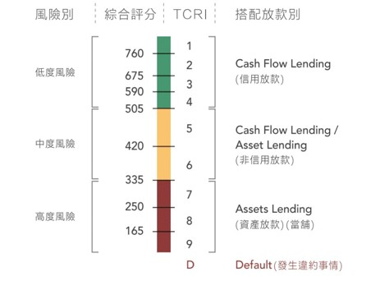
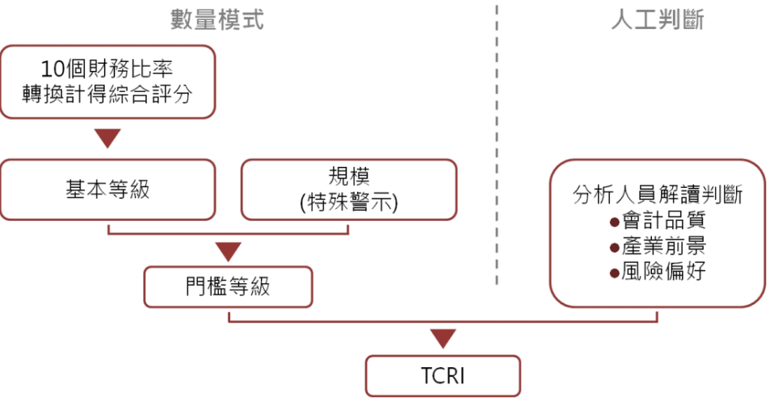
Introduction
Taiwan Corporate Credit Risk Index
TCRI | Count | Percentage
5 | 2054 | 31.0%
6 | 2161 | 32.6%
7 | 1389 | 20.9%
8 | 667 | 10.1%
9 | 292 | 4.4%
D | 292 | 0.8%
C | 2 | 0.03%
Machine Learning Approaches to Scoring and Rating Prediction
Notes:
TEJ產業研究團隊於1991年推出，台灣企業信用風險指標 Taiwan Corporate Credit Risk Index，採半專家模式，以數量模式為底，輔以人工判斷，並拆分成三個步驟

Slide 3
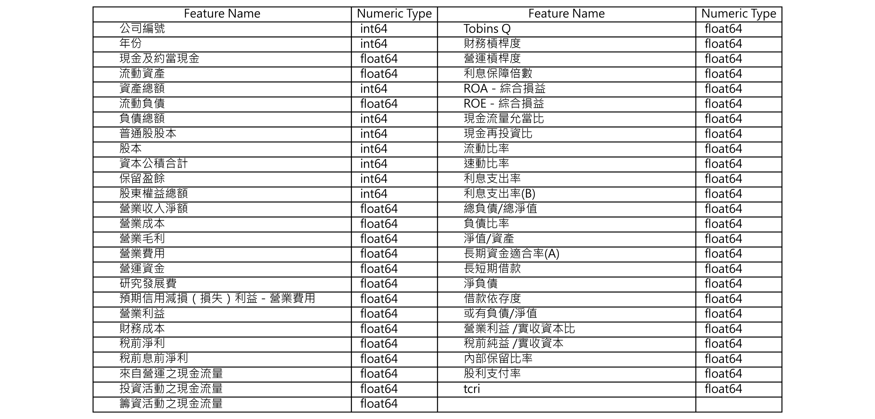
Data (EDA)
Data Types
Machine Learning Approaches to Scoring and Rating Prediction

Slide 4
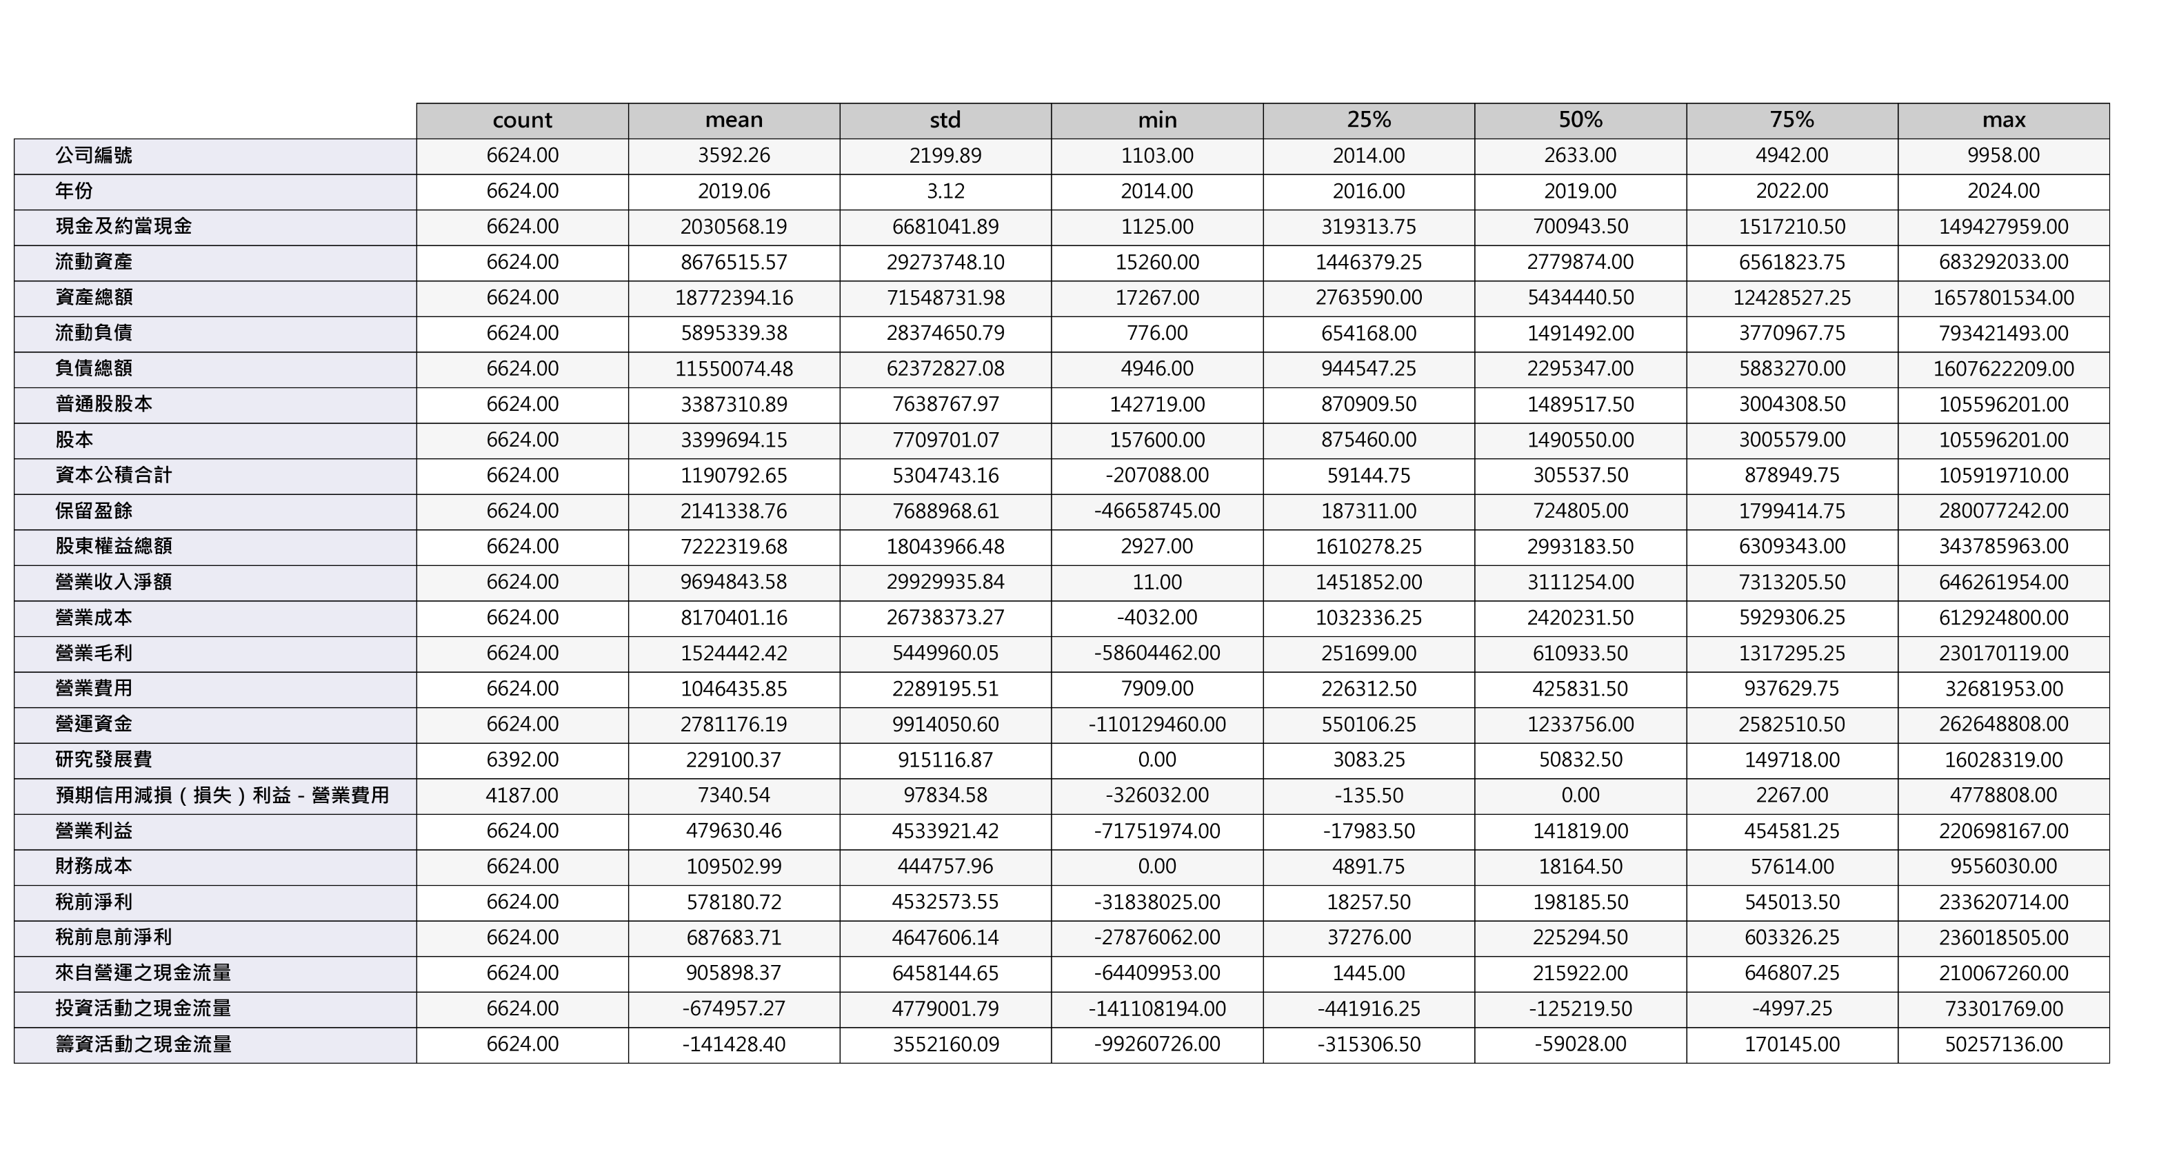
Data (EDA)
Data Describe 1/2
Machine Learning Approaches to Scoring and Rating Prediction

Slide 5
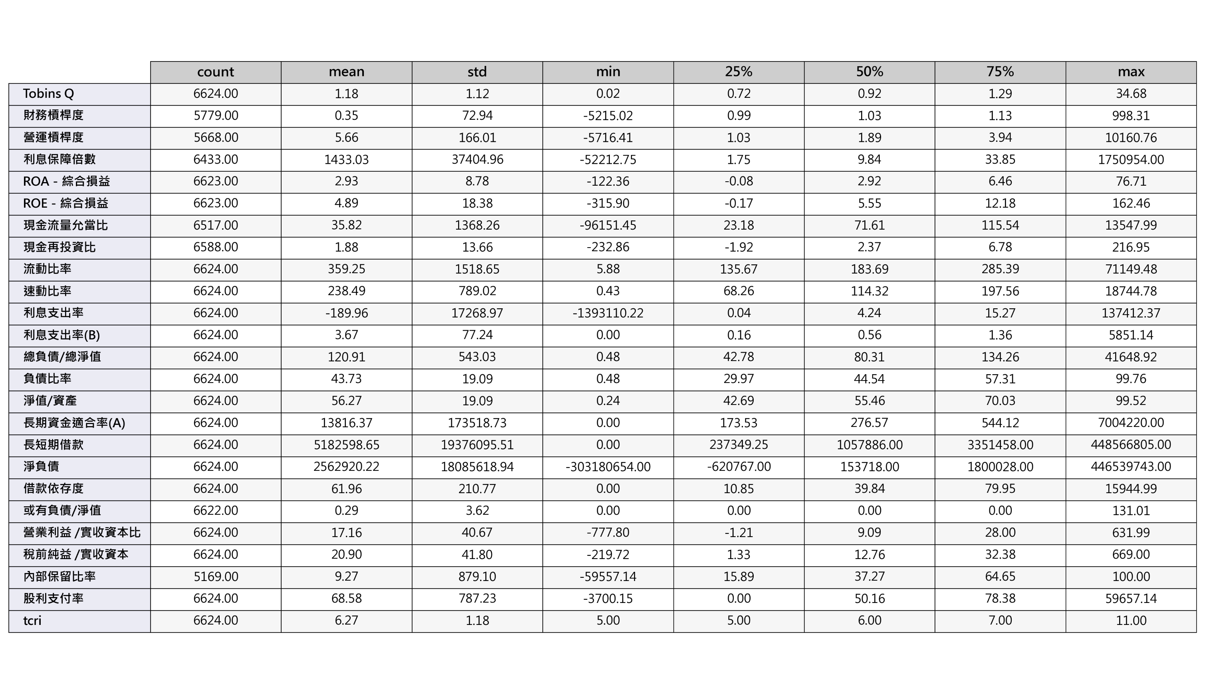
Data (EDA)
Data Describe 2/2
Machine Learning Approaches to Scoring and Rating Prediction

Slide 6
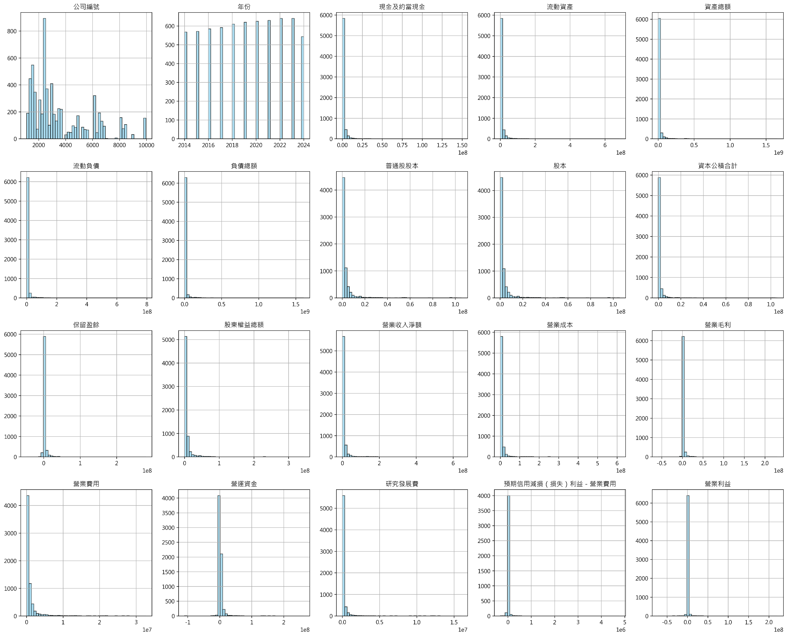
Data (EDA)
Histogram 1/3
Machine Learning Approaches to Scoring and Rating Prediction

Slide 7
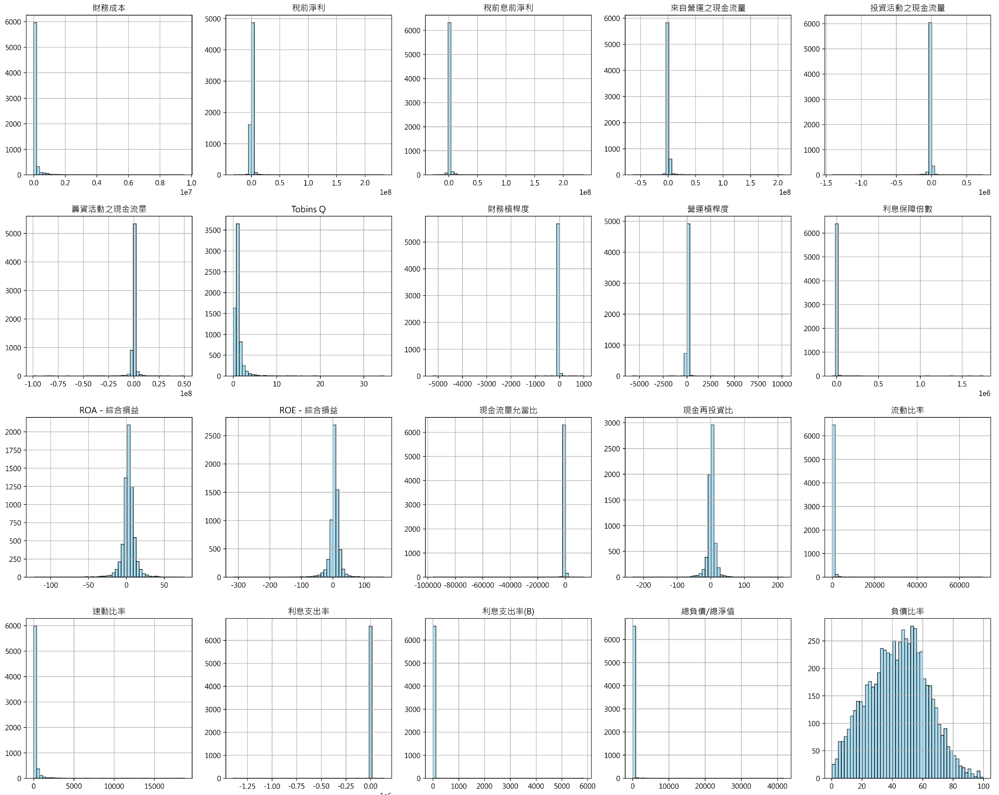
Data (EDA)
Histogram 2/3
Machine Learning Approaches to Scoring and Rating Prediction

Slide 8
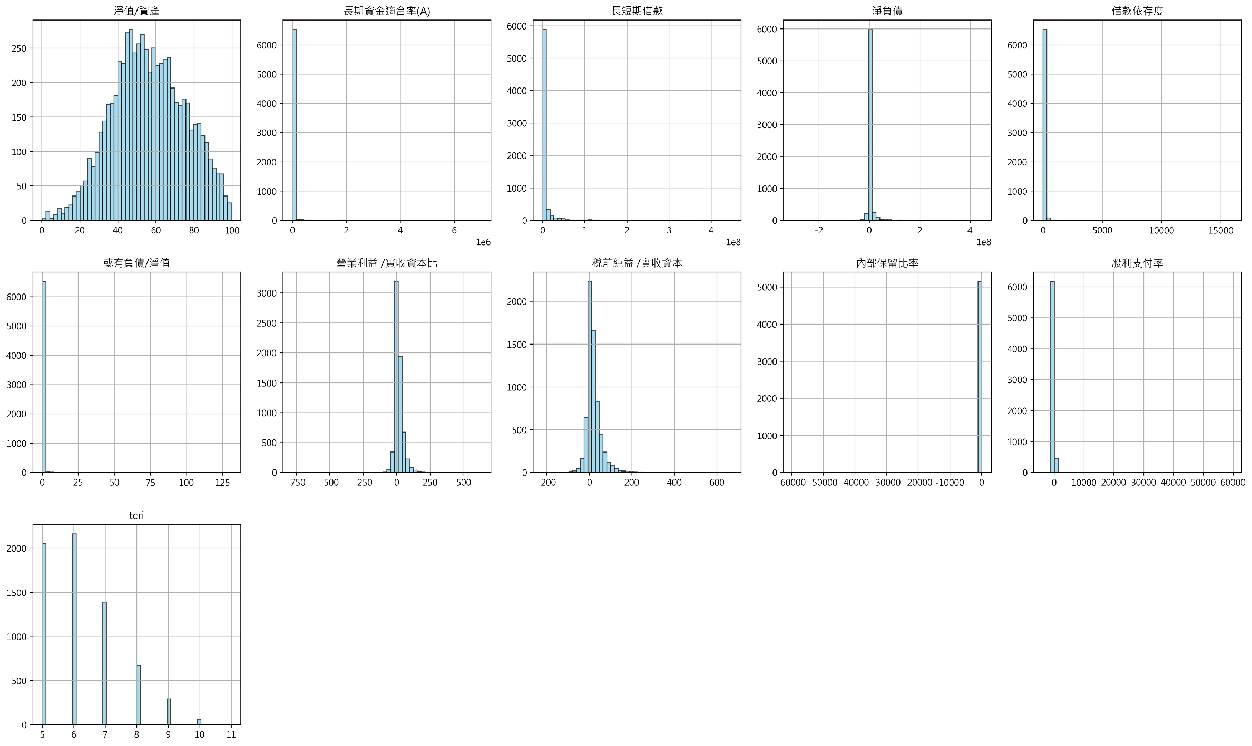
Data (EDA)
Histogram 3/3
Machine Learning Approaches to Scoring and Rating Prediction

Slide 9
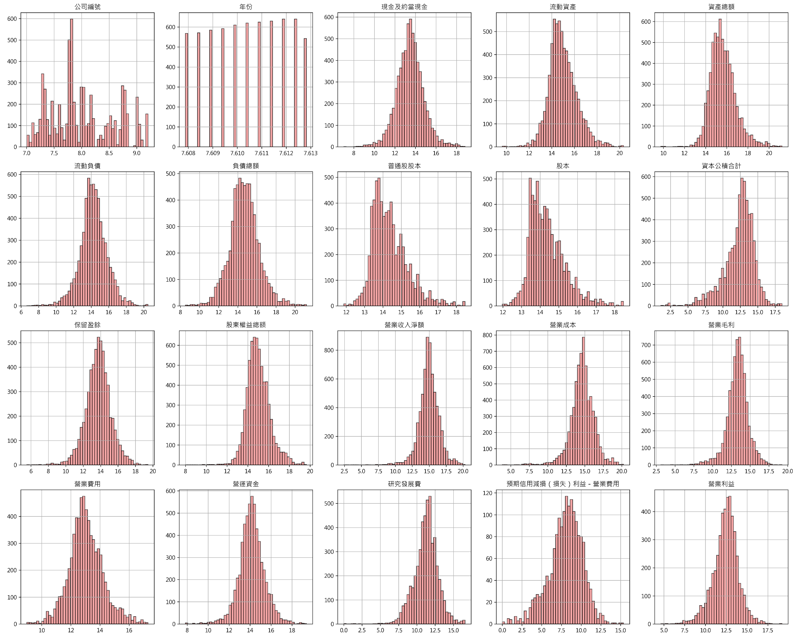
Data (EDA)
Histogram (ln) 1/3
Machine Learning Approaches to Scoring and Rating Prediction

Slide 10
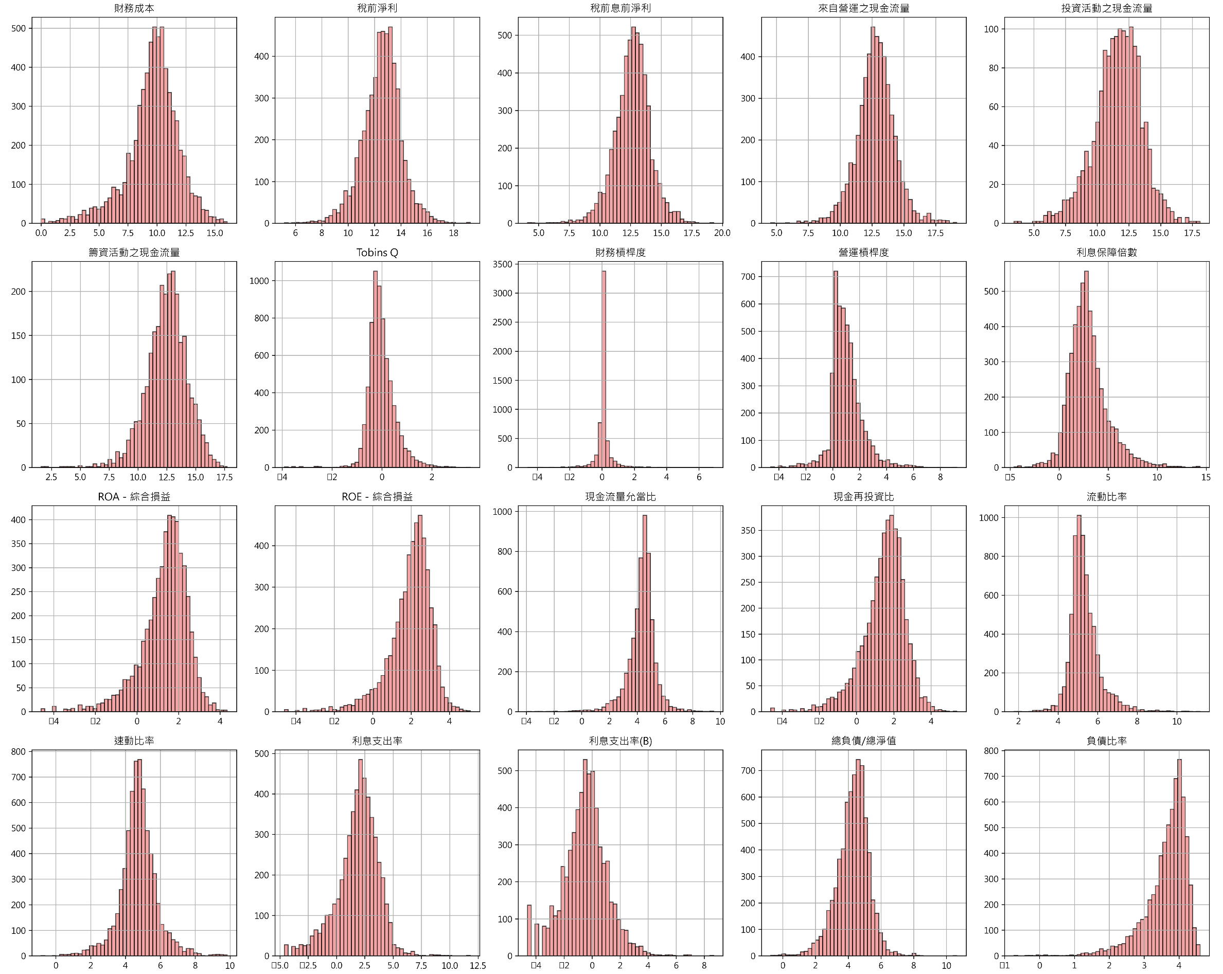
Data (EDA)
Histogram (ln) 2/3
Machine Learning Approaches to Scoring and Rating Prediction

Slide 11
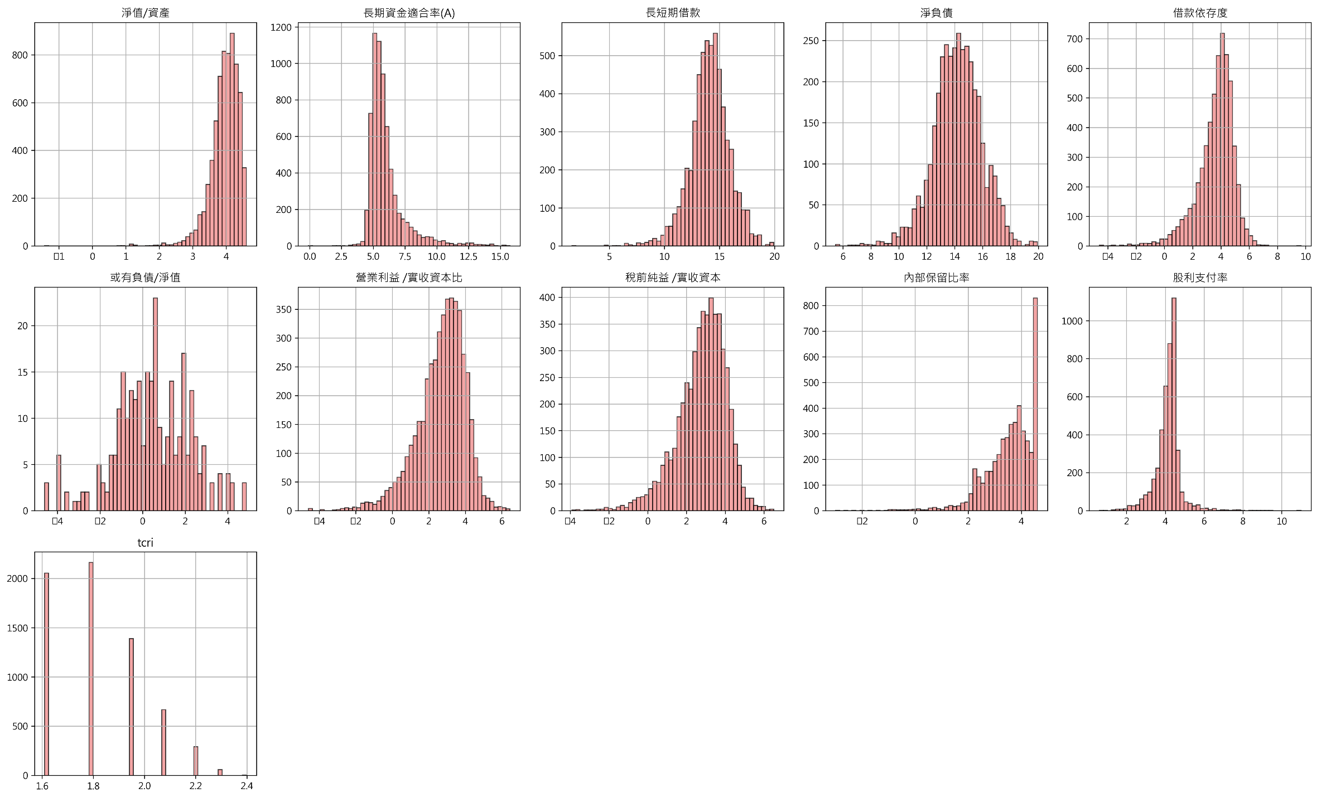
Data (EDA)
Histogram (ln) 3/3
Machine Learning Approaches to Scoring and Rating Prediction

Slide 12
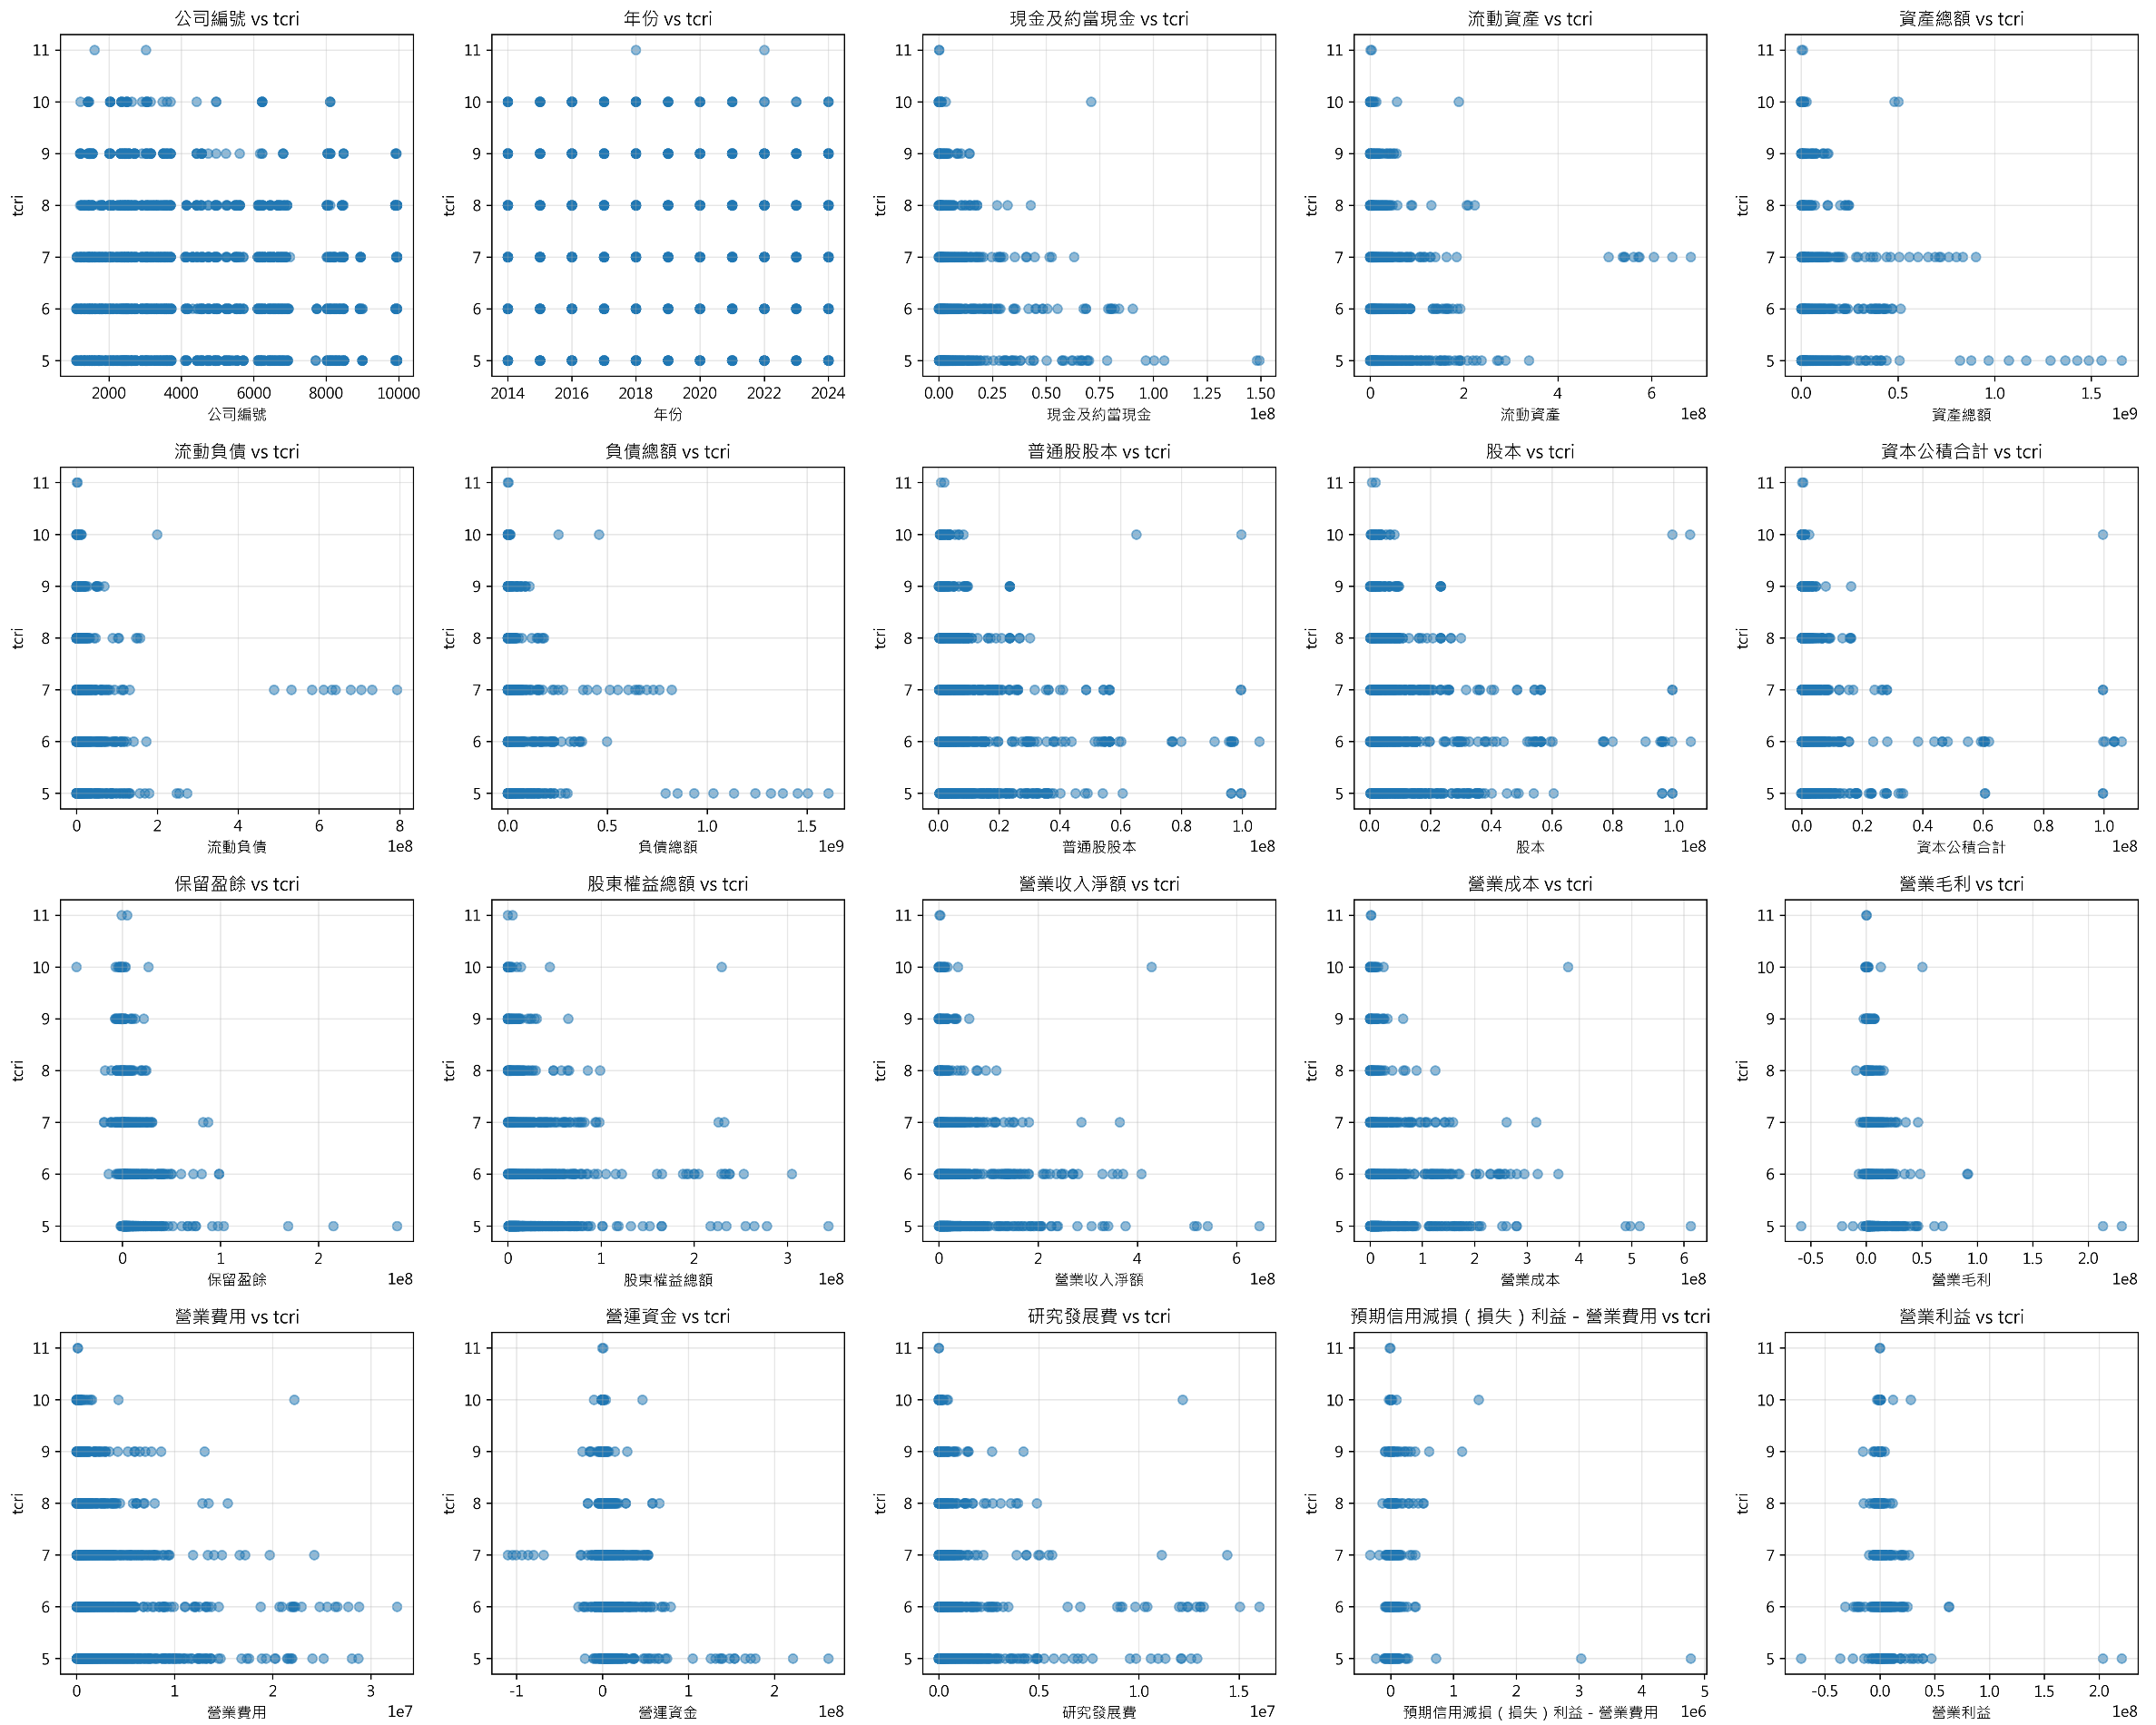
Data (EDA)
Scatter Plot 1/3
Machine Learning Approaches to Scoring and Rating Prediction

Slide 13
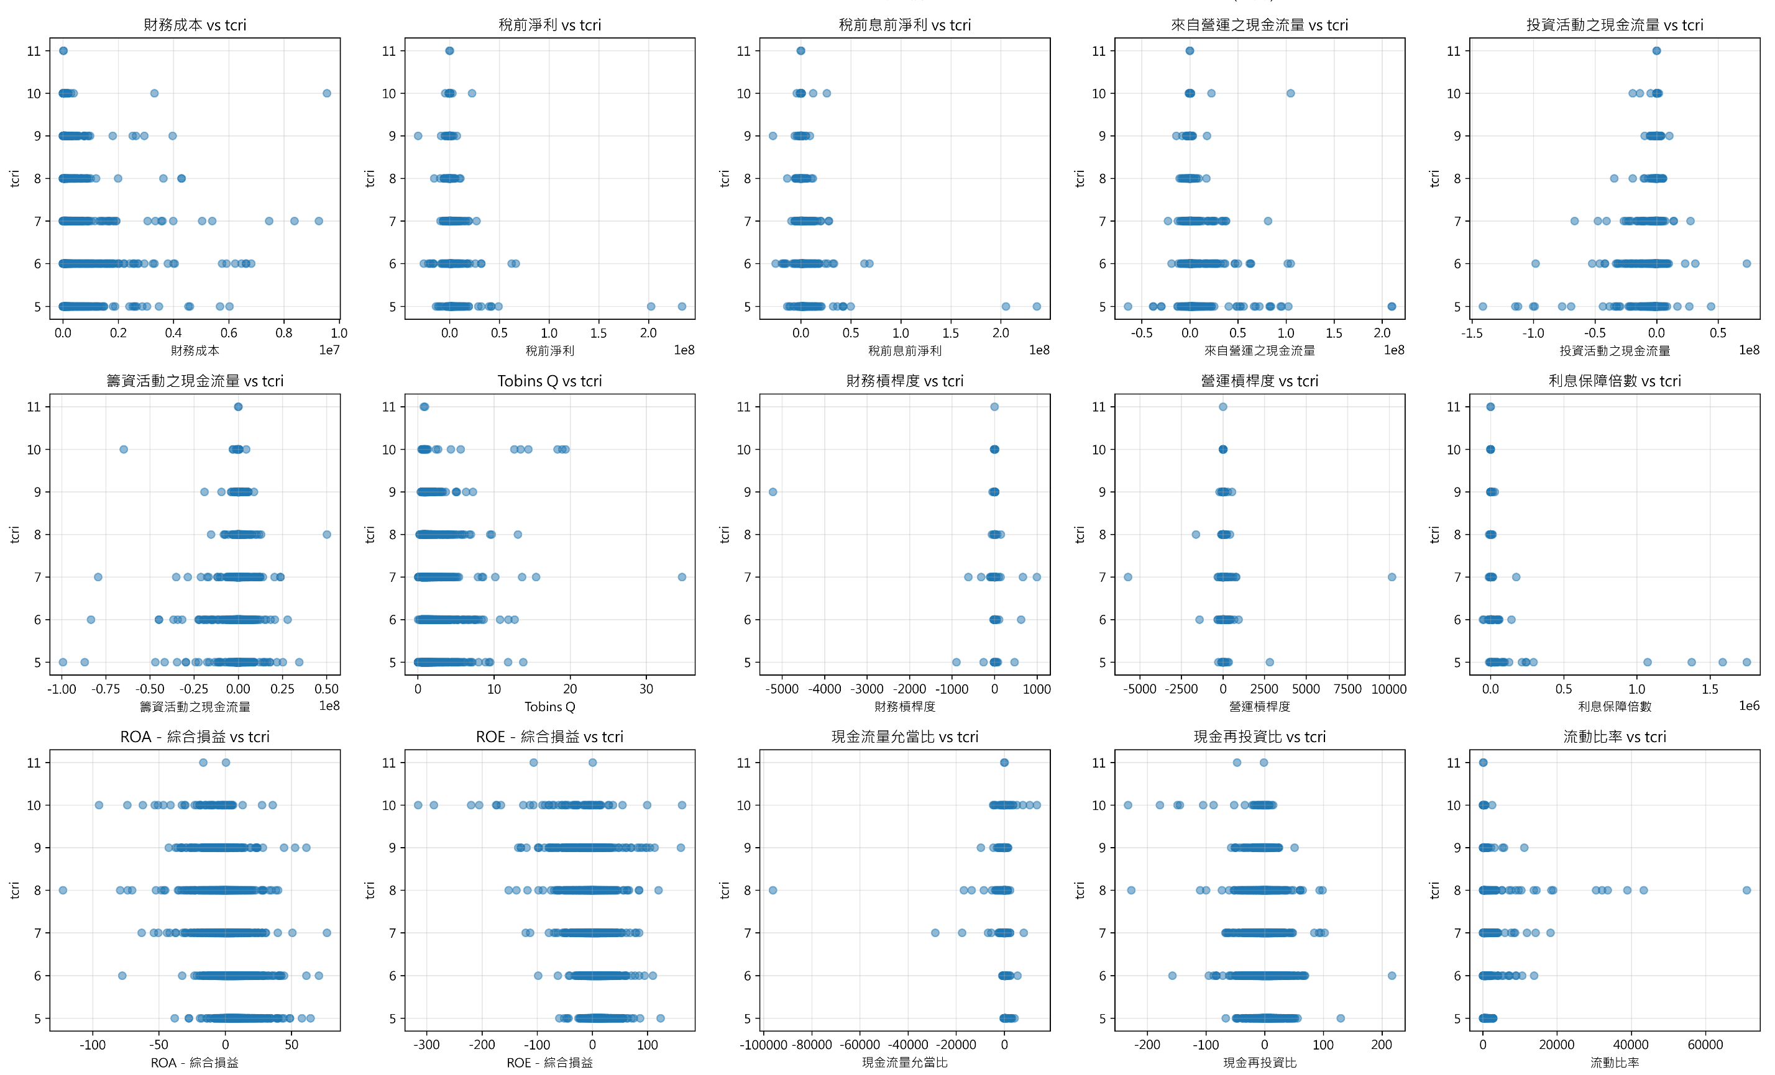
Data (EDA)
Scatter Plot 2/3
Machine Learning Approaches to Scoring and Rating Prediction

Slide 14
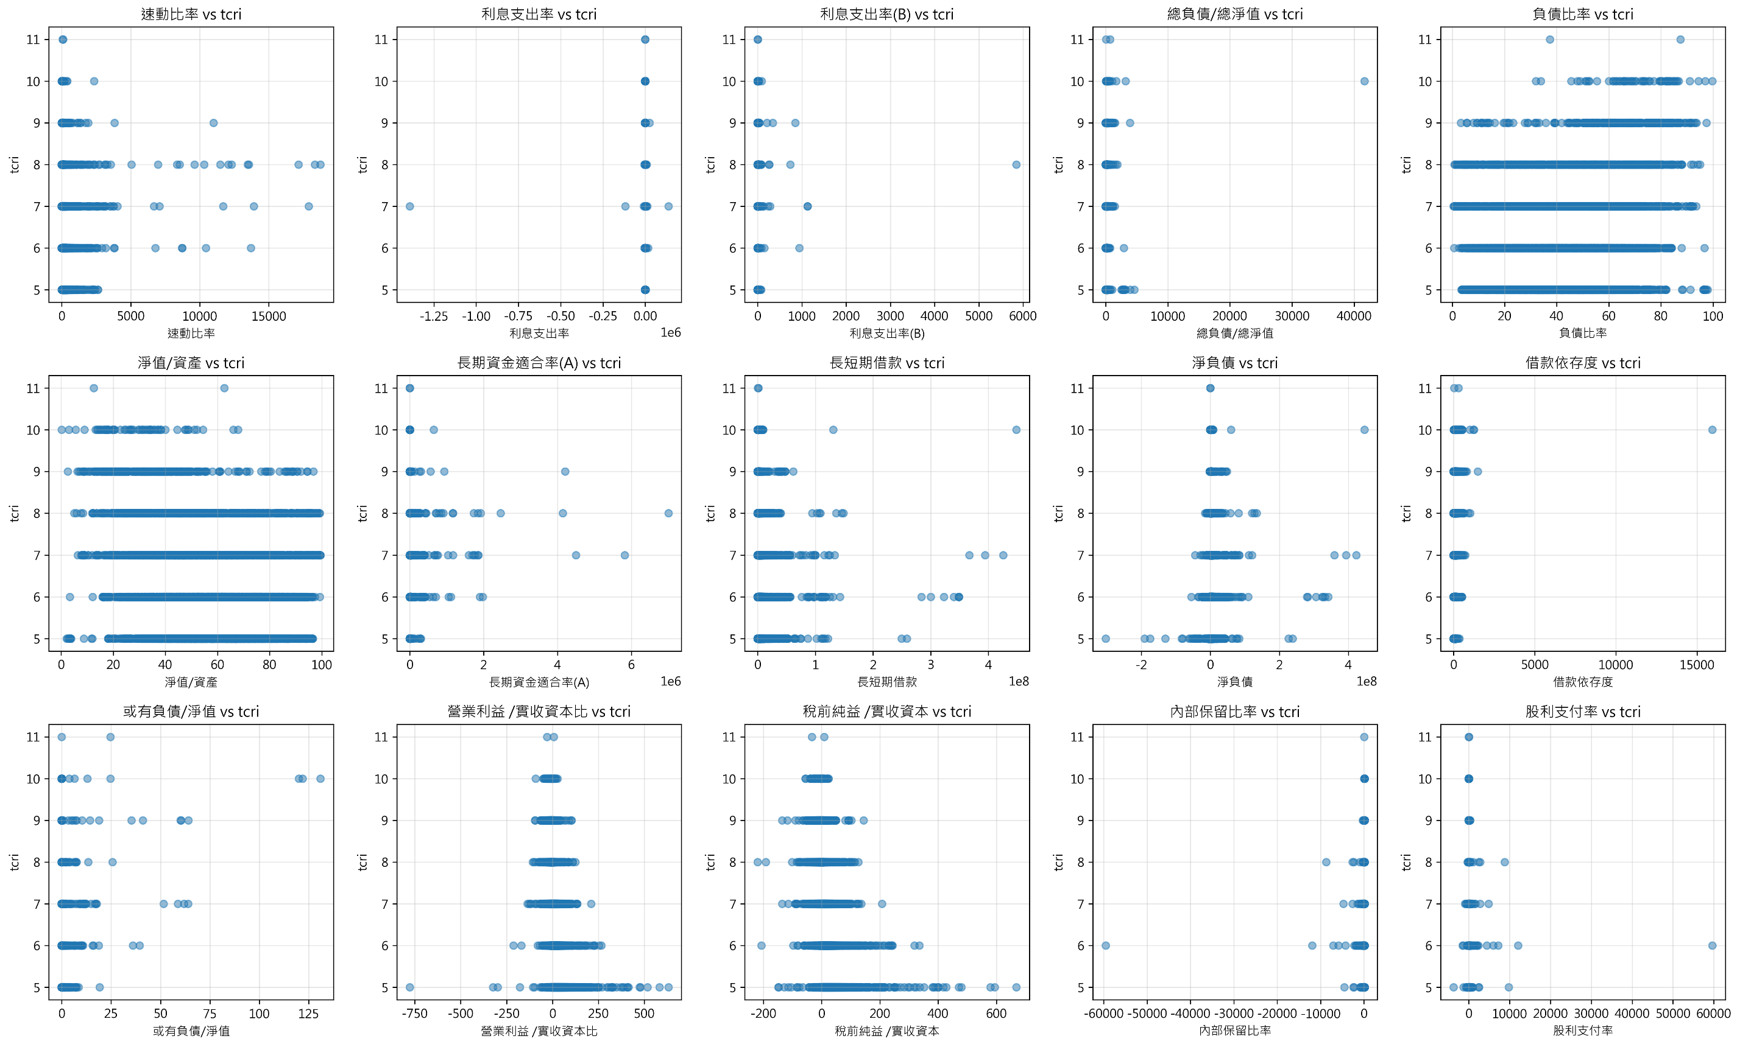
Data (EDA)
Scatter Plot 3/3
Machine Learning Approaches to Scoring and Rating Prediction

Slide 15
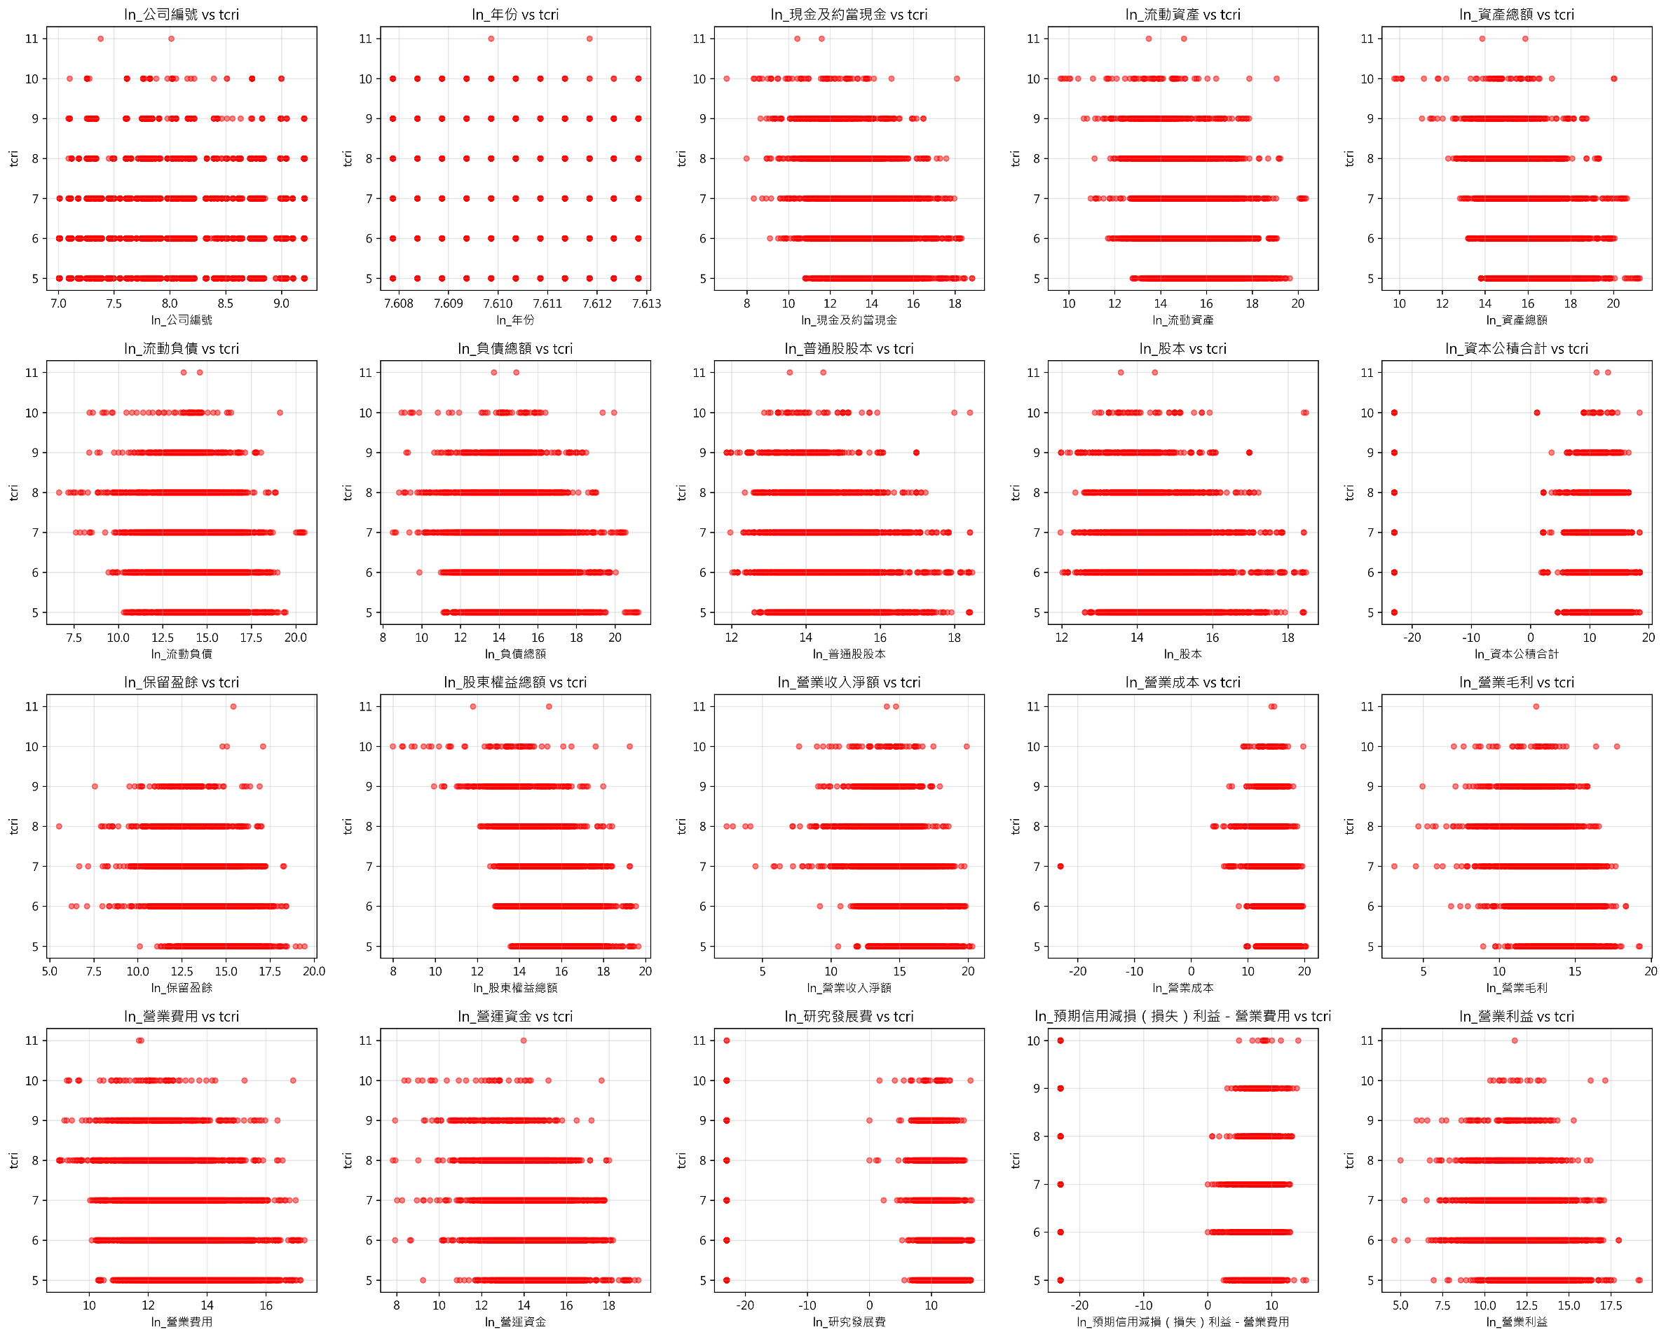
Data (EDA)
Scatter Plot (ln) 1/3
Machine Learning Approaches to Scoring and Rating Prediction

Slide 16
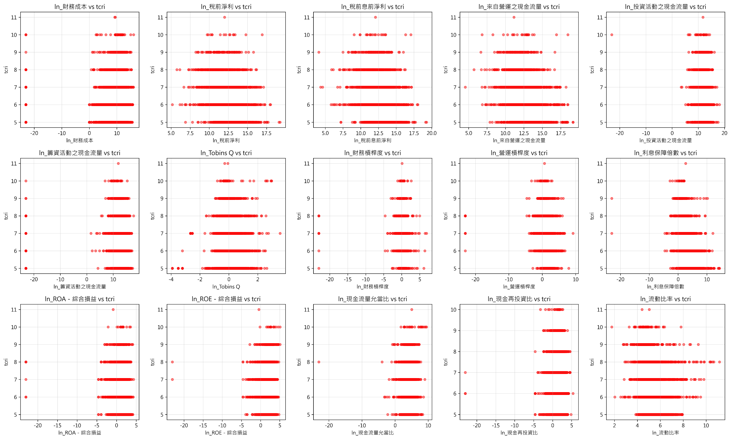
Data (EDA)
Scatter Plot (ln) 2/3
Machine Learning Approaches to Scoring and Rating Prediction

Slide 17
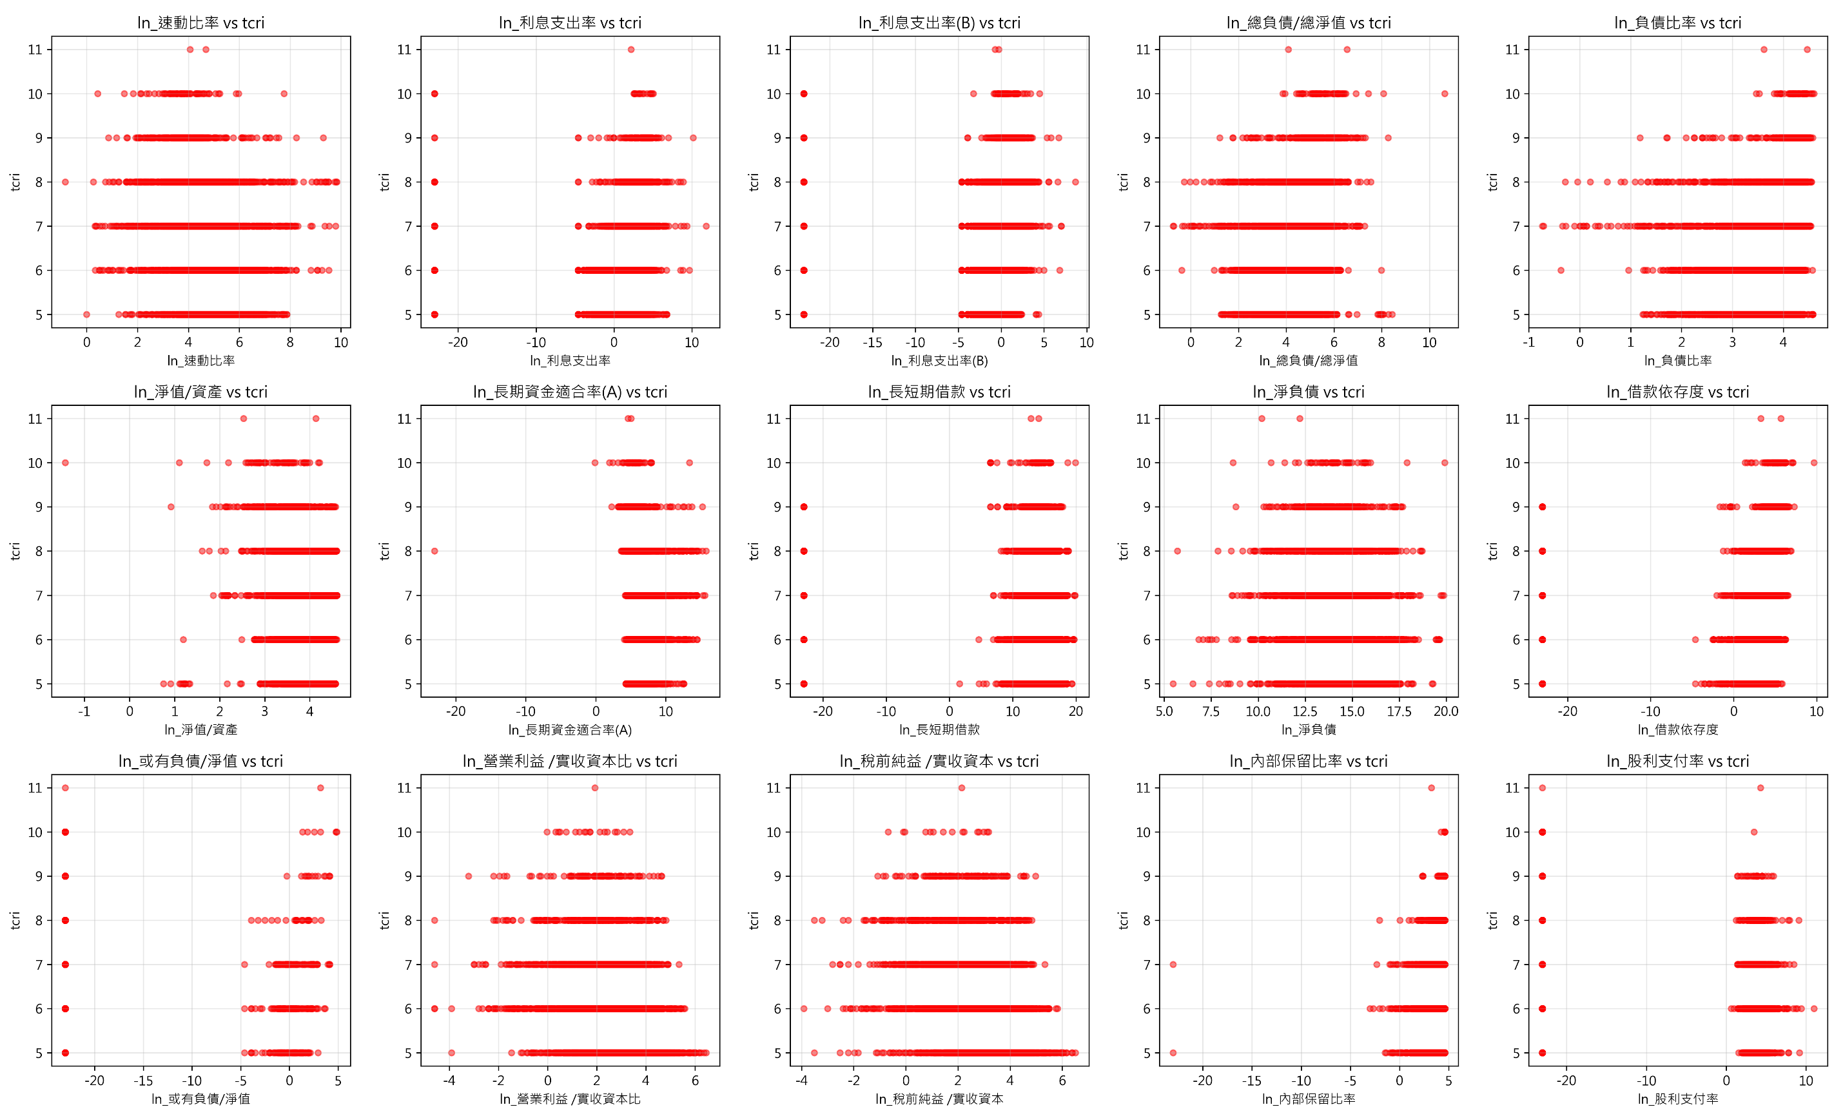
Data (EDA)
Scatter Plot (ln) 3/3
Machine Learning Approaches to Scoring and Rating Prediction

Slide 18
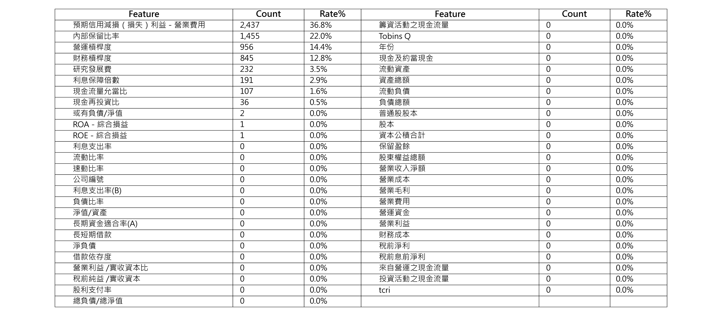
Data (EDA)
Missing Value
Machine Learning Approaches to Scoring and Rating Prediction

Slide 19
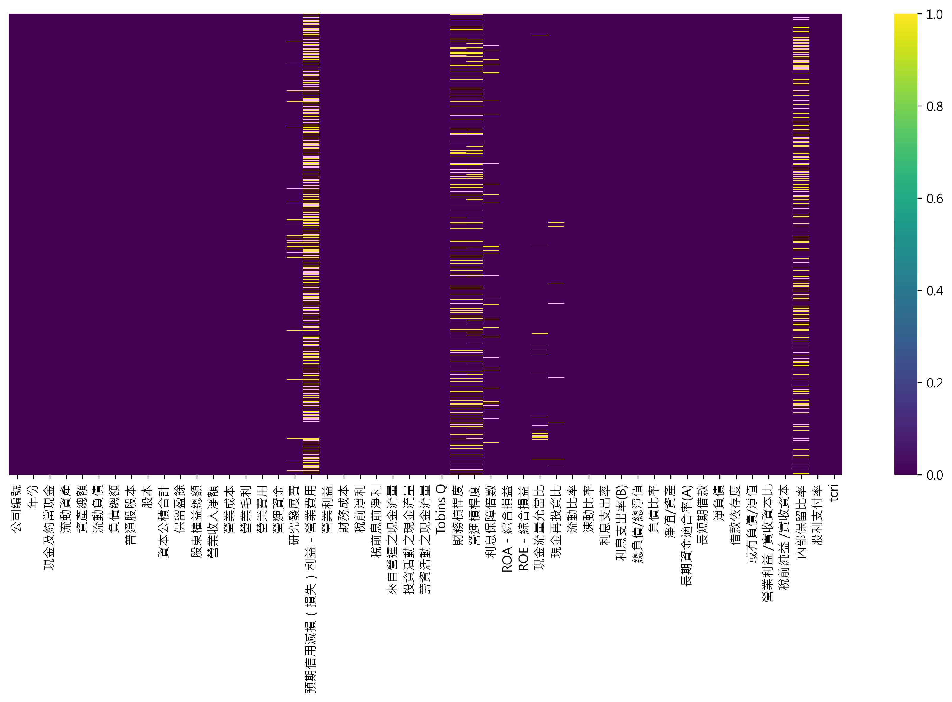
Data (EDA)
Missing Value Heatmap
Machine Learning Approaches to Scoring and Rating Prediction

Slide 20
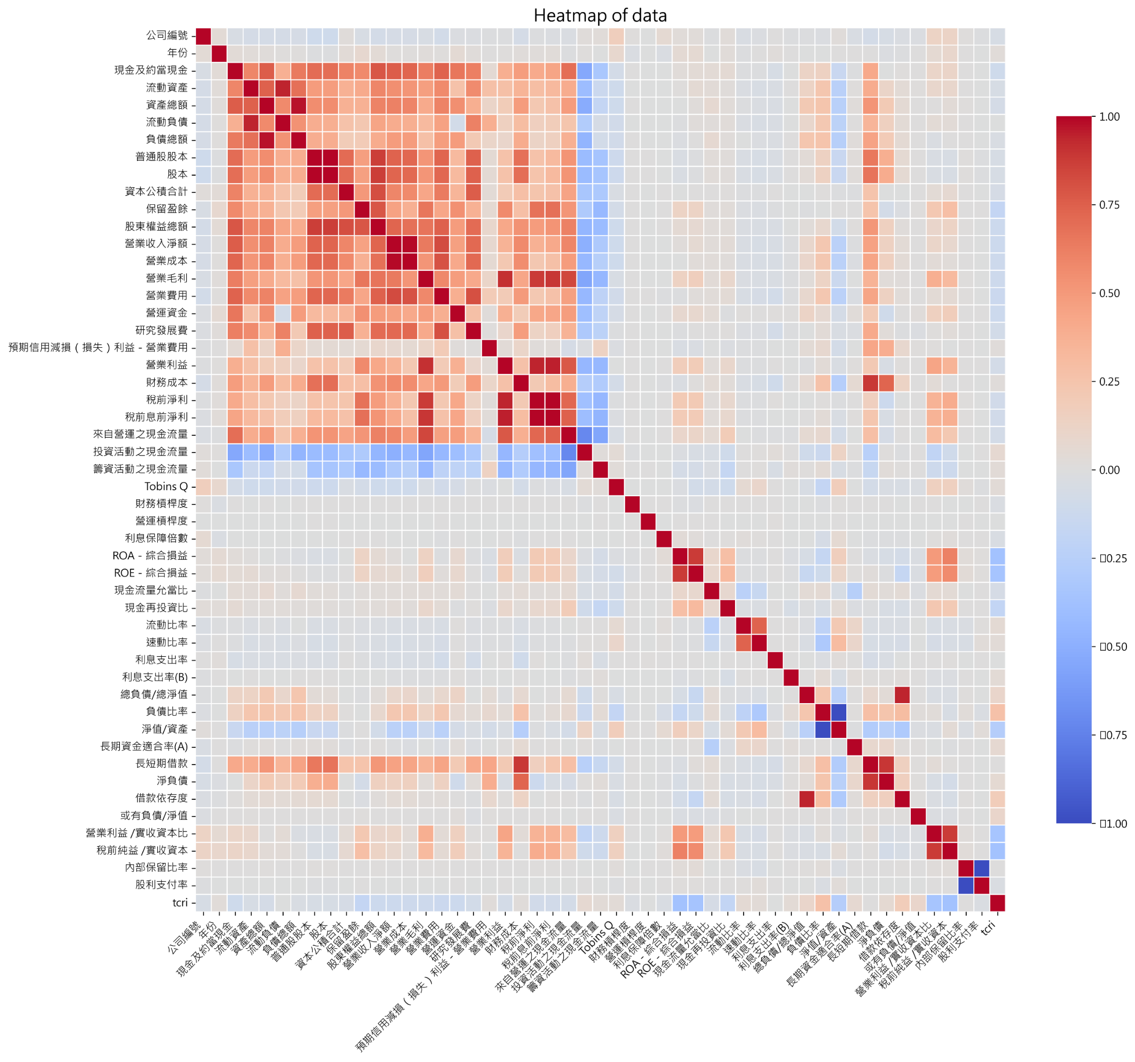
Data (EDA)
Machine Learning Approaches to Scoring and Rating Prediction

Slide 21
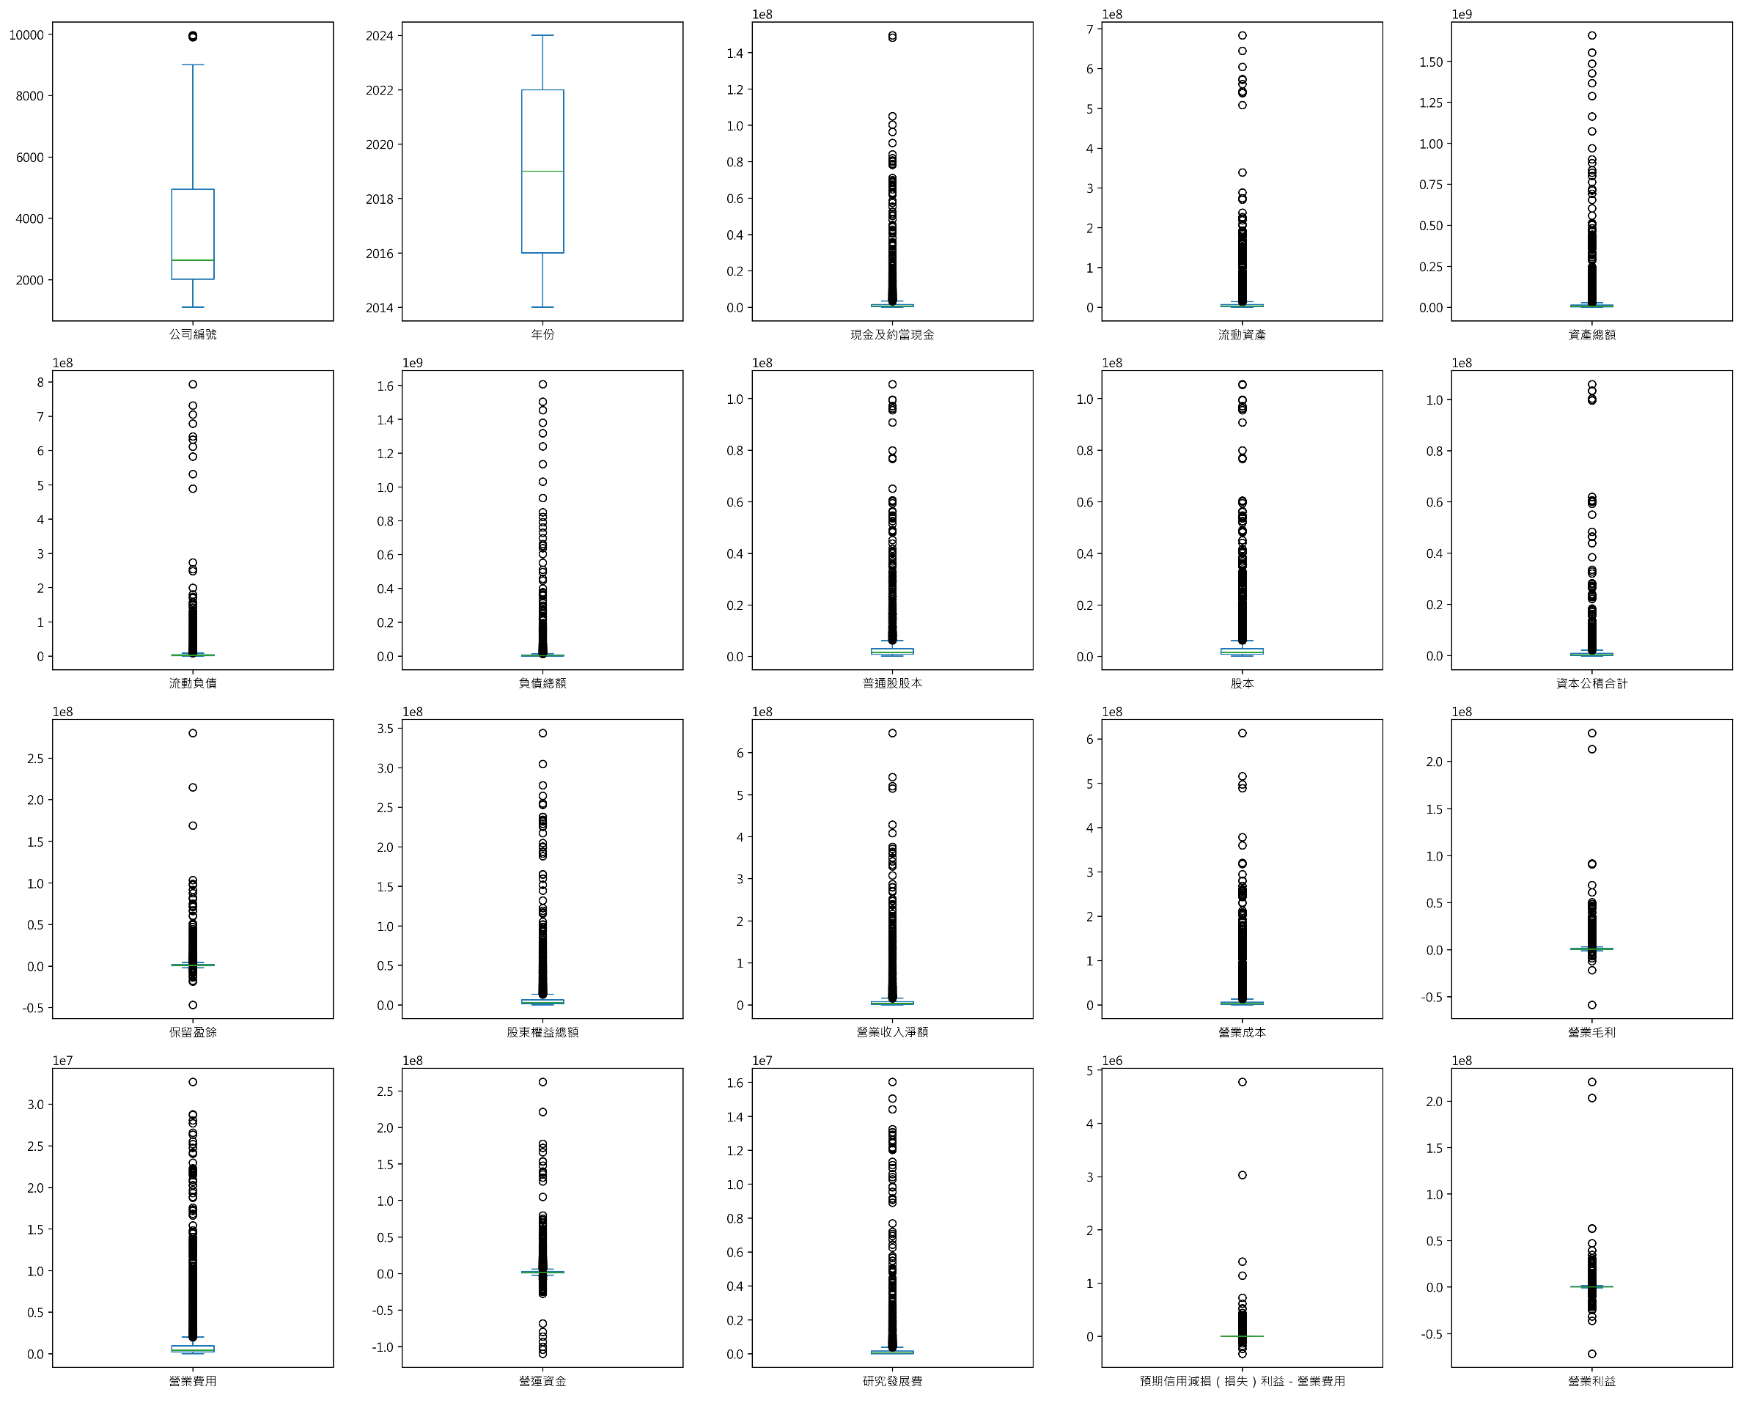
Data (EDA)
Exploratory Data Analysis (EDA)
Machine Learning Approaches to Scoring and Rating Prediction

Slide 22
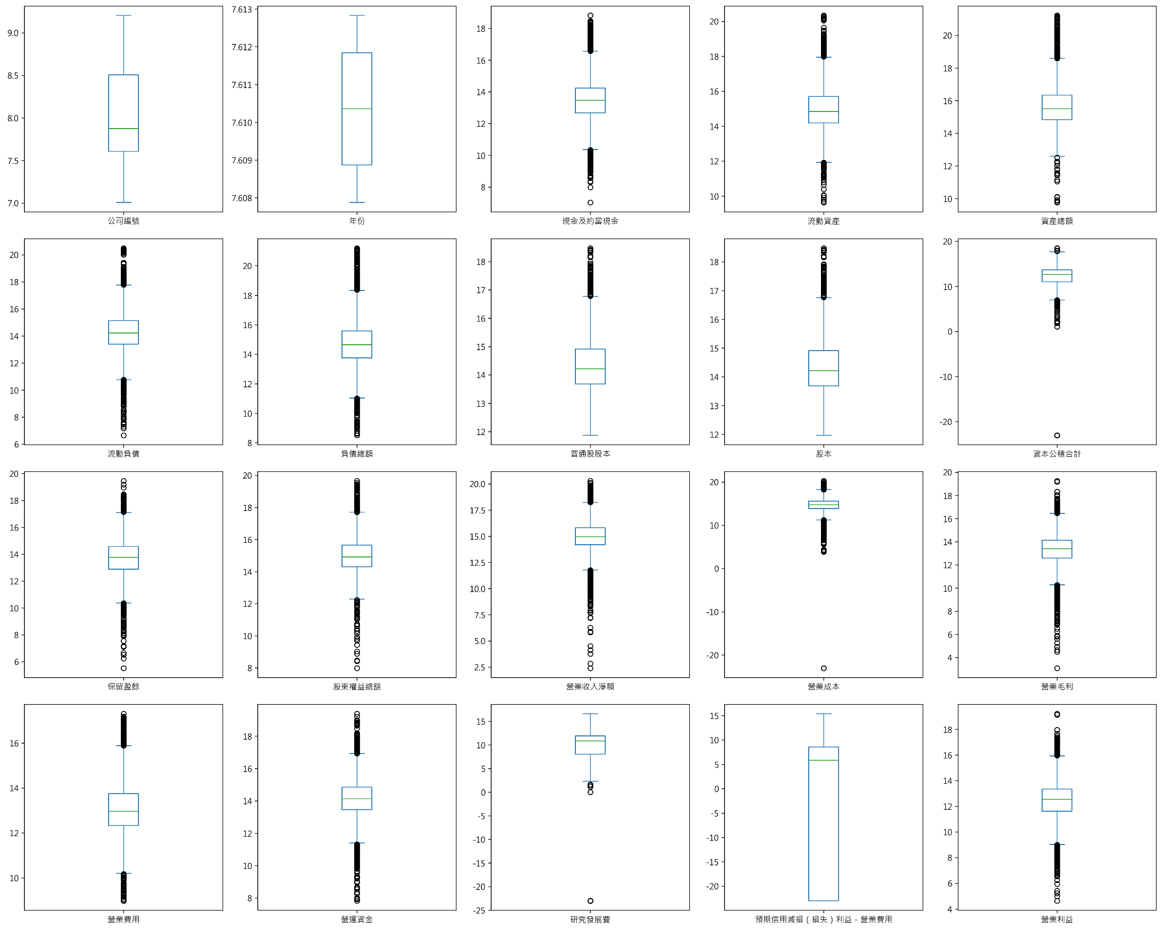
Data
Exploratory Data Analysis (EDA)
Machine Learning Approaches to Scoring and Rating Prediction

